Slide 1

DEPARTMENT OF COMPUTER SCIENCE & ENGINEERING
Title: AI-ENABLED RISK SCORING SYSTEM FOR AUTOMATED DETECTION OF
SCAM JOB ADVERTISEMENTS
BATCH ID : 23MPCS-F11
S. No | Roll. No | Student Name
1 | 23881A05AB | K. Sharath Chandra
2 | 23881A05AH | M. Jyoshna
3 | 23881A05AK | M. Palani
Guide Details
Dr.S.Srinivas Reddy
Assistant Professor Department of CSE

Slide 2
Mini Project Review Outlines
Main idea of the Project
Existing System Vs Proposed
Proposed Project Objectives
Proposed Project Outcomes
Software and Hardware Requirements
Process Model
Architectural Diagram
Proposed Methods and Algorithms
Results
Research paper (Acceptance Proof)
Conclusion
DEPARTMENT OF CSE MINI PROJECT
2

Slide 3
Main Idea Of The Project
Job Scam Detection
Existing systems for detecting scam job advertisements mainly rely on manual review, rule-based filtering, user reporting, and basic machine learning methods.
Protect job seekers from online fraud.
Improve trust in online job platforms.
The system analyzes a job posting and classifies it as Real or Fake.
Reduce financial and data loss caused by job scams.
Categorizes jobs into low, medium, and high risk
Uses Explainable AI (XAI) to show reasons behind decisions
3

Slide 4
Existing System Vs Proposed
Existing System
Existing systems mainly rely on manual verification of job postings.
Detection is slow and inconsistent
Fraudulent job ads may reach job seekers before being removed.
Proposed System
Faster and more accurate scam detection.
Generates a risk score for each job post.
Warns the users before they interact with suspicious job postings
Gives real job posting links and websites

Slide 5
Proposed Project Objectives
To develop an AI-based system for detecting fake job postings.
To provide instant feedback about the authenticity of job postings.
To analyze linguistic patterns, recruiter details, and salary information in job advertisements.
To create a user-friendly platform for quick job verification.
To develop a risk scoring system that evaluates the credibility of job postings.

Slide 6
Proposed Project Outcomes
Automates detection of fraudulent job postings, reducing manual effort and improving accuracy.
Uses AI and NLP to analyze job content and identify scam-related patterns.
Provides a risk score to help users assess job listing credibility.
Offers explainable results, increasing transparency and user trust.
Includes a user-friendly interface for quick and easy scam detection.
Enhances safety and reliability of online job platforms.
Continuously improves detection accuracy by learning from new data and emerging scam patterns.

Slide 7
Software and Hardware Requirements
Hardware Requirements
Computer / Laptop
Storage: 500GB Hard Disk
Minimum 4GB RAM
Storage for database
Software Requirements
Python
Google collab, Github
Pandas, NumPy, Scikit-learn, NLTK
SQLite / MySQL Database
VS Code / PyCharm

Slide 8
Process Model
The project follows the Machine Learning Development Process.
Steps:
Data Collection
Data Preprocessing
Feature Extraction
Model Training
Risk Scoring
Explainable AI
Prediction

Slide 9
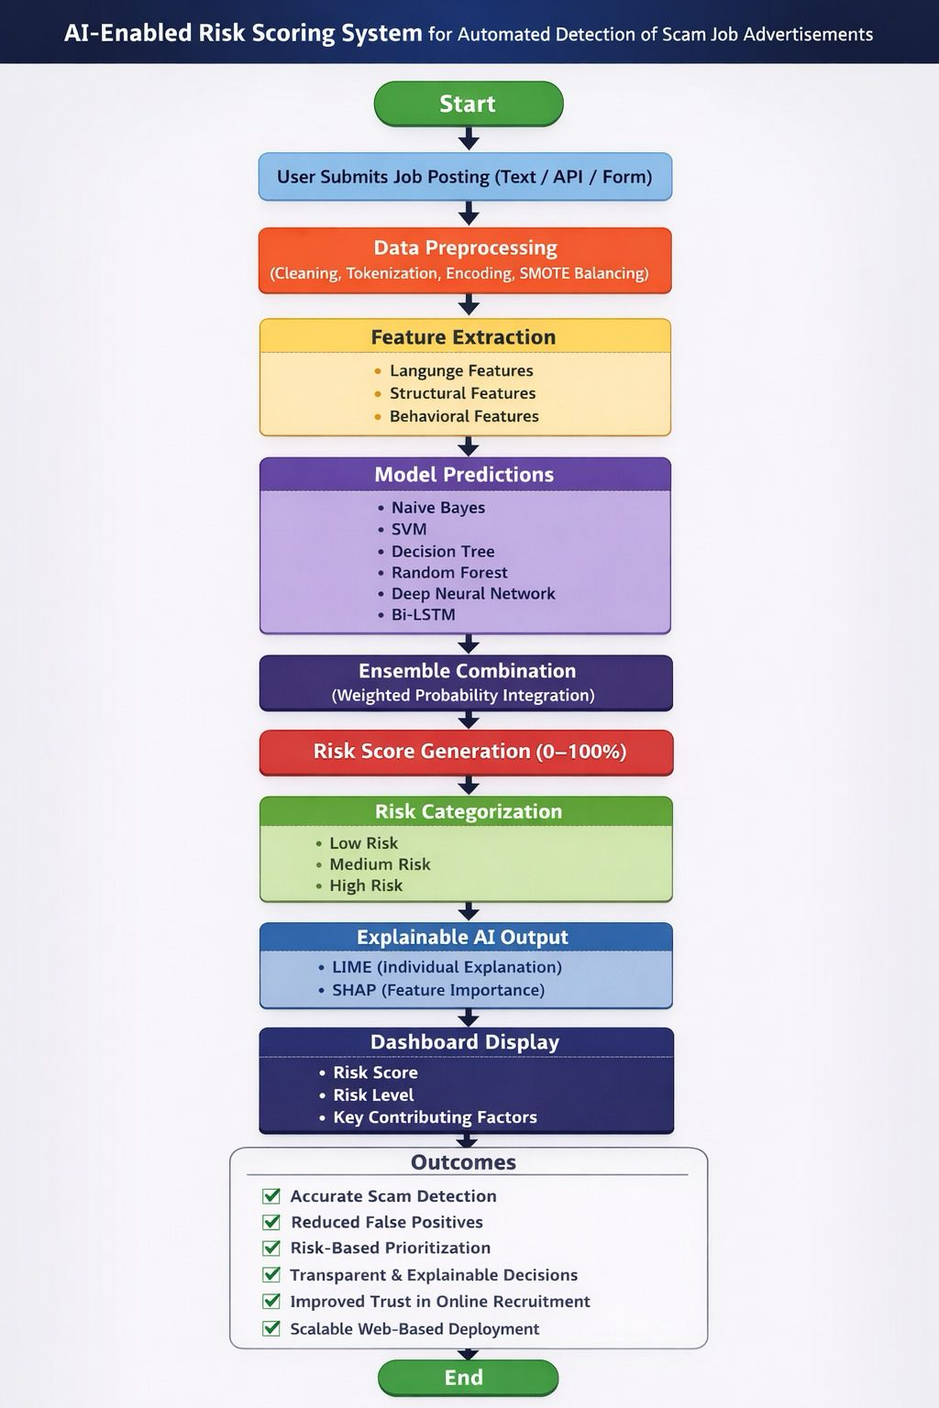
Architectural Diagram
DEPARTMENT OF CSE MINI PROJECT
9

Slide 10
Proposed Method And Algorithms
Proposed Method
The system uses an AI-based pipeline to detect job scams by analyzing job descriptions. First, job data is collected and preprocessed (cleaning text, removing stopwords, tokenization). Then, features are extracted from the text using NLP techniques. A trained machine learning model classifies the job posting as genuine or fraudulent. Finally, a risk score and explanation are generated and displayed through a user-friendly interface.

Slide 11
Proposed Method And Algorithms
Algorithms Used
Natural Language Processing (NLP) – for text cleaning, tokenization, and feature extraction.
TF-IDF (Term Frequency–Inverse Document Frequency) – to convert text into numerical features.
Machine Learning Classifiers – such as Logistic Regression / Naive Bayes / Random Forest for classification.
Risk Scoring Algorithm – assigns a credibility score based on model output.
Explainable AI (XAI) (e.g., LIME/SHAP) – to provide reasons behind predictions.

Slide 12
Results
High accuracy achieved in detecting fraudulent job postings.
Significant reduction in manual effort and verification time.
Effective identification of scam patterns like fake salaries and payment requests.
Reliable risk scoring system for evaluating job credibility.
Clear and interpretable results using Explainable AI techniques.
Fast and real-time analysis of job descriptions.
Improved user confidence and safer job search experience.

Slide 13
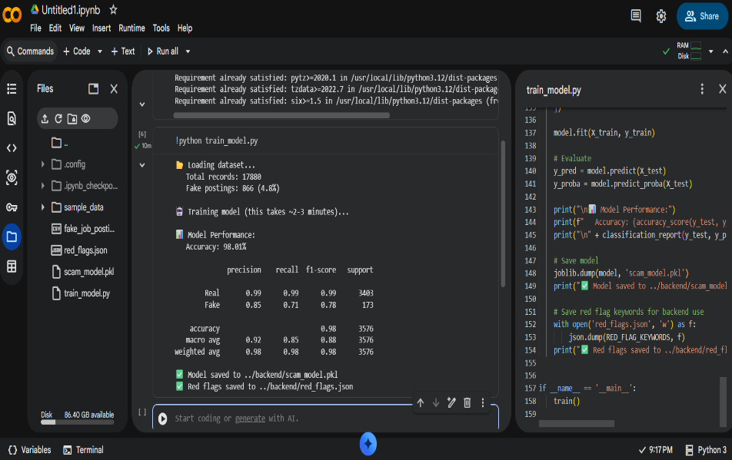
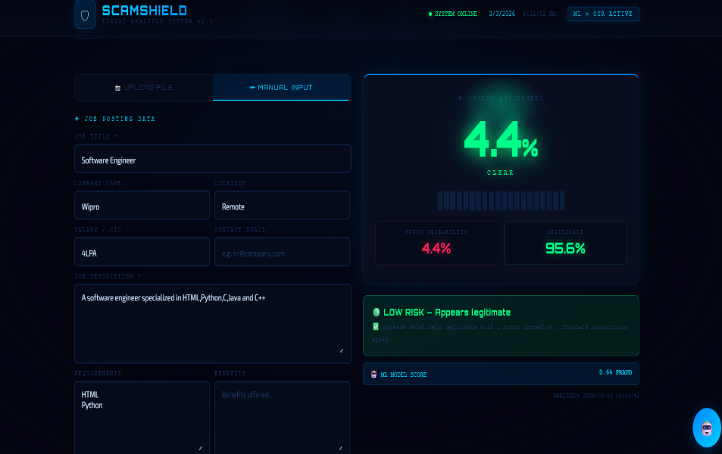
Fig 2: Risk scoring of job posting
Results
Fig 1: Model Performance

Slide 14
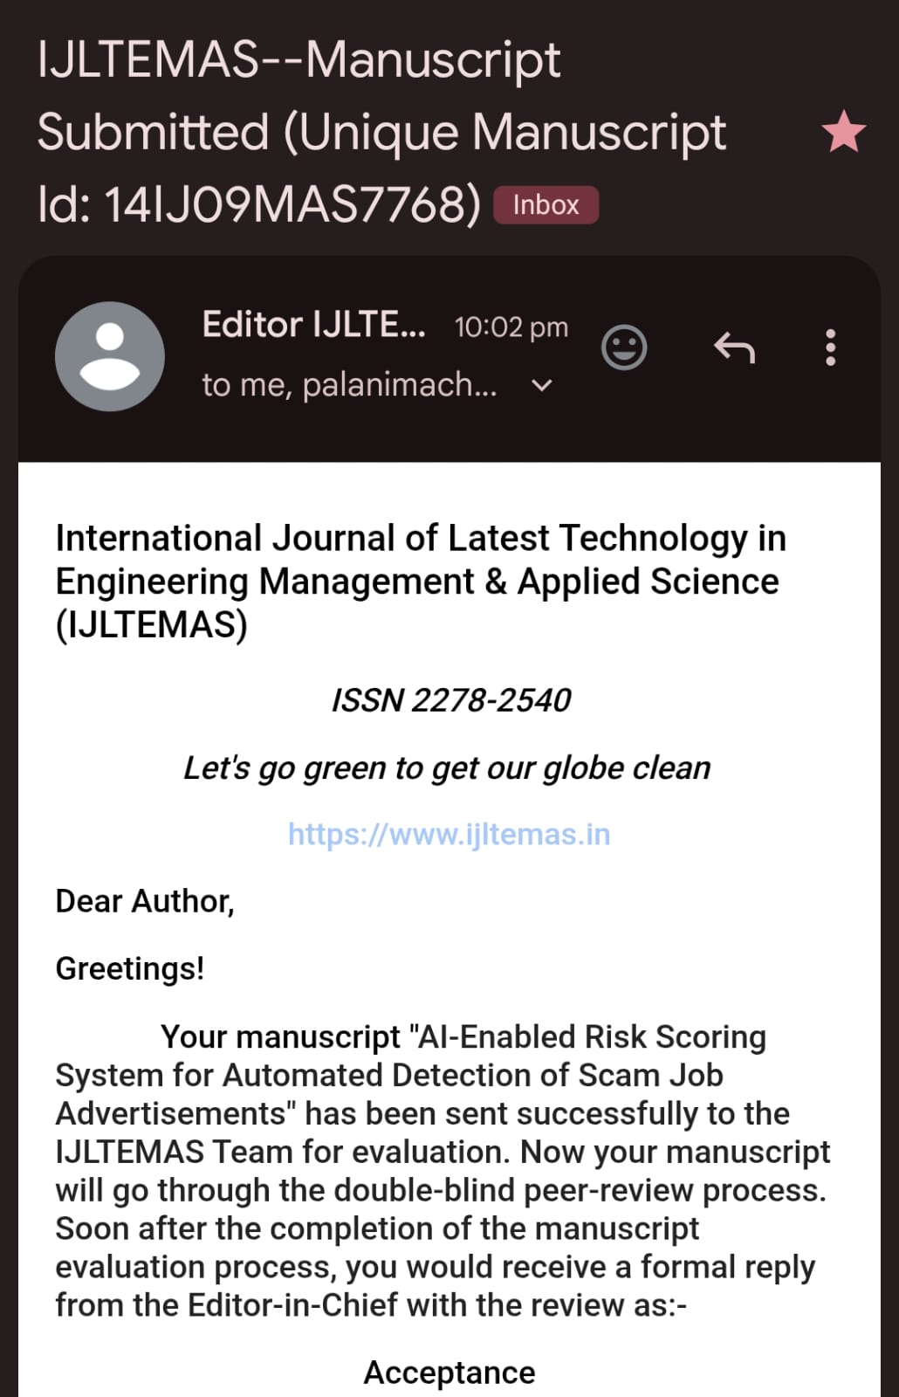
Status: Applied
Research Paper Acceptance

Slide 15
Conclusion
The AI-based Job Scam Detection system successfully demonstrates an effective approach to identifying fraudulent job postings with high accuracy. By integrating Natural Language Processing techniques, the system is able to analyze job descriptions and detect hidden scam patterns such as unrealistic offers and suspicious language. The implementation of a risk scoring model allows users to make informed decisions, while the use of Explainable AI ensures transparency by providing clear reasons for each prediction. Additionally, the user-friendly interface makes the system accessible and practical for everyday use. Overall, the project significantly enhances the safety, reliability, and trustworthiness of online job platforms, helping protect users from potential scams

Slide 16
Thank You

